Slide 1


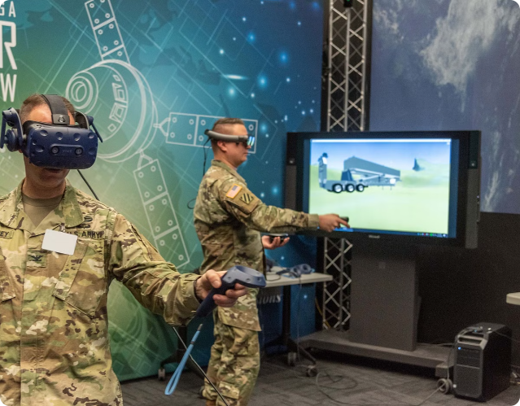
Introduction to Live Military Training Using VR
Virtual reality (VR) is transforming how the military conducts training exercises. By immersing soldiers in realistic 3D simulations, VR enables them to hone their skills and prepare for real-world combat scenarios in a safe, controlled environment.
By pacifico

Slide 2
Benefits of VR for Military Training
Increased Safety
Cost Savings
Improved Retention
VR eliminates the risks associated with live-fire drills, reducing injuries and damage to equipment.
VR training is more cost-effective than traditional live exercises, which require expensive resources and logistics.
The immersive nature of VR enhances soldiers' ability to retain and apply what they've learned.

Slide 3

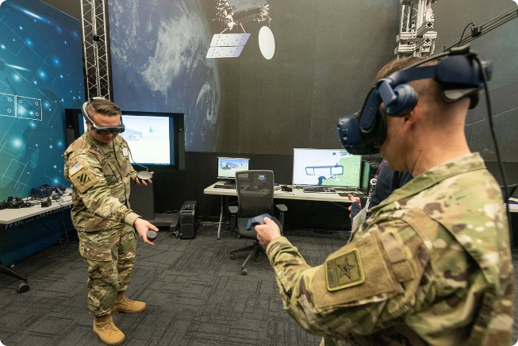
Immersive Battlefield Simulations
1
Terrain Replication
VR environments accurately recreate the terrain, weather, and other environmental factors of real-world battlefields.
2
Dynamic Scenarios
Simulations can be customized to present soldiers with a variety of evolving challenges and threats.
3
Collaborative Training
VR enables soldiers to train together, practicing communication, coordination, and teamwork in a virtual setting.

Slide 4

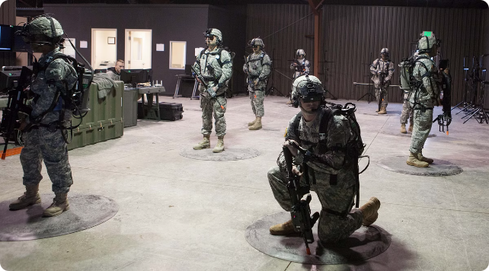
Scenario-Based Training Exercises
1
Hostage Rescue
Soldiers can practice coordinating a complex hostage extraction operation in a realistic VR environment.
2
Urban Warfare
VR simulations can recreate the challenges of urban combat, including navigating tight spaces and identifying targets.
3
Disaster Response
Soldiers can train for humanitarian aid missions, such as delivering supplies and providing medical assistance.

Slide 5


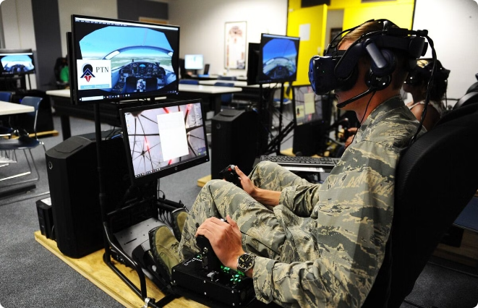


Enhancing Situational Awareness
360-Degree Visibility
VR headsets provide soldiers with a fully immersive, 360-degree field of view, improving their situational awareness.
Thermal Imaging
VR simulations can incorporate thermal imaging technology, allowing soldiers to detect heat signatures and hidden threats.
Night Vision
VR training can simulate low-light conditions, enabling soldiers to practice using night vision equipment effectively.

Slide 6

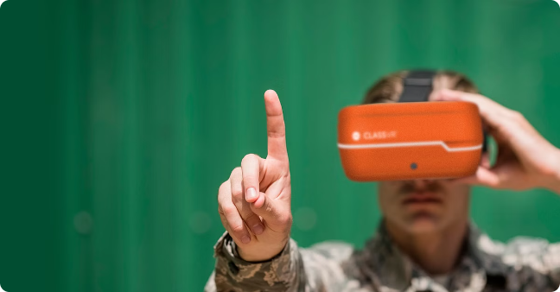
Reducing Training Costs and Risks
Cost-Effective
VR training is more cost-effective than live-fire exercises, which require expensive resources and logistical support.
Risk Mitigation
VR training eliminates the risks associated with live-fire drills, such as injuries and damage to equipment.
Scalable Deployment
VR systems can be easily deployed and scaled to accommodate the training needs of large military units.

Slide 7


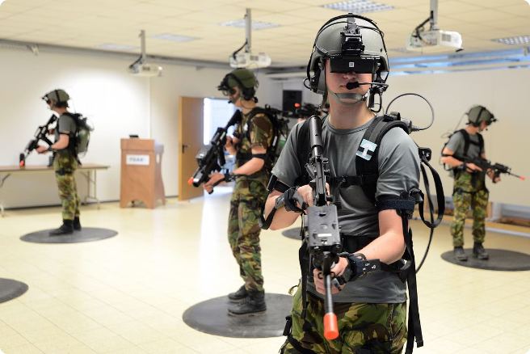


Integrating VR with Existing Training Programs
Assessment
VR training can be used to evaluate soldiers' skills and identify areas for improvement.
Skill Development
VR simulations can be tailored to help soldiers hone their tactical, decision-making, and communication skills.
Certification
VR training can be integrated into existing certification programs to ensure soldiers are prepared for real-world missions.

Slide 8

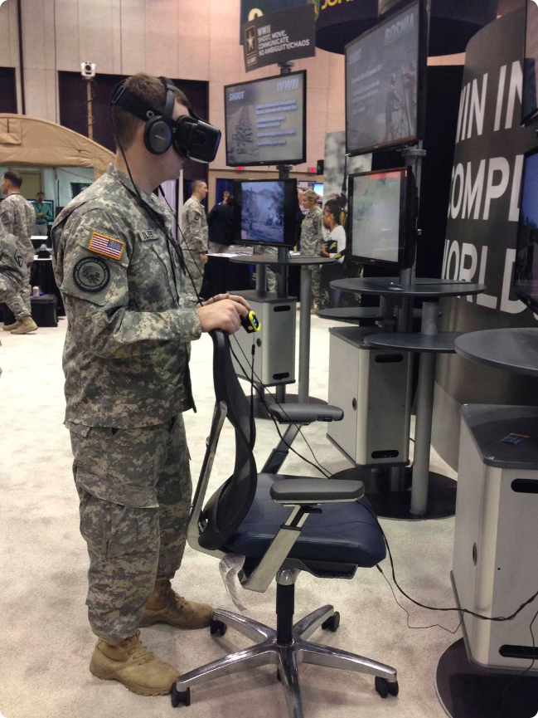
The Future of VR in Military Training
Advancements in Hardware
Improved resolution, field of view, and haptic feedback will enhance the realism of VR training.
Artificial Intelligence
AI-driven adversaries and simulated environments will make VR training more dynamic and challenging.
Networked Simulations
Soldiers will be able to train together in large-scale, interconnected VR environments, fostering teamwork and coordination.

